Slide 1
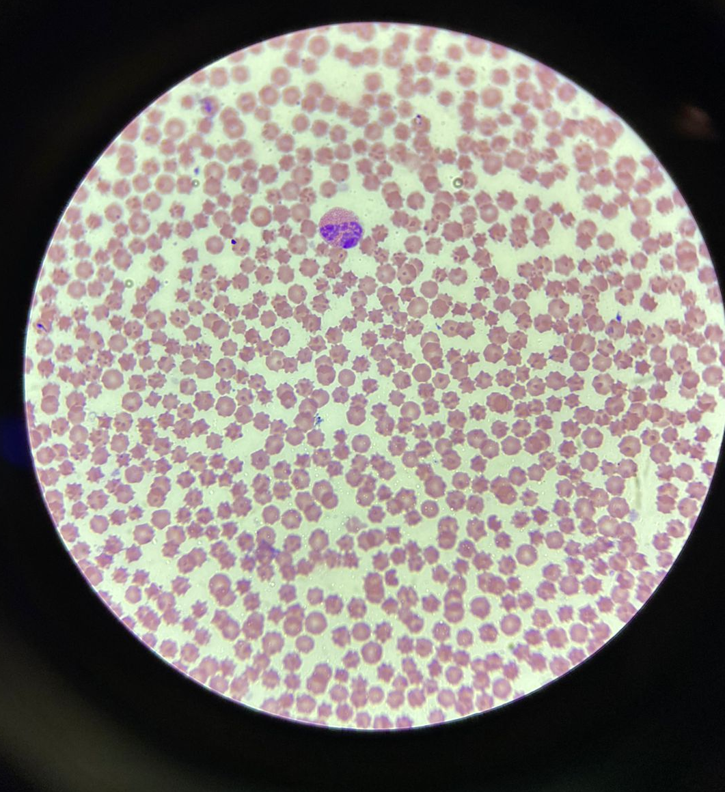
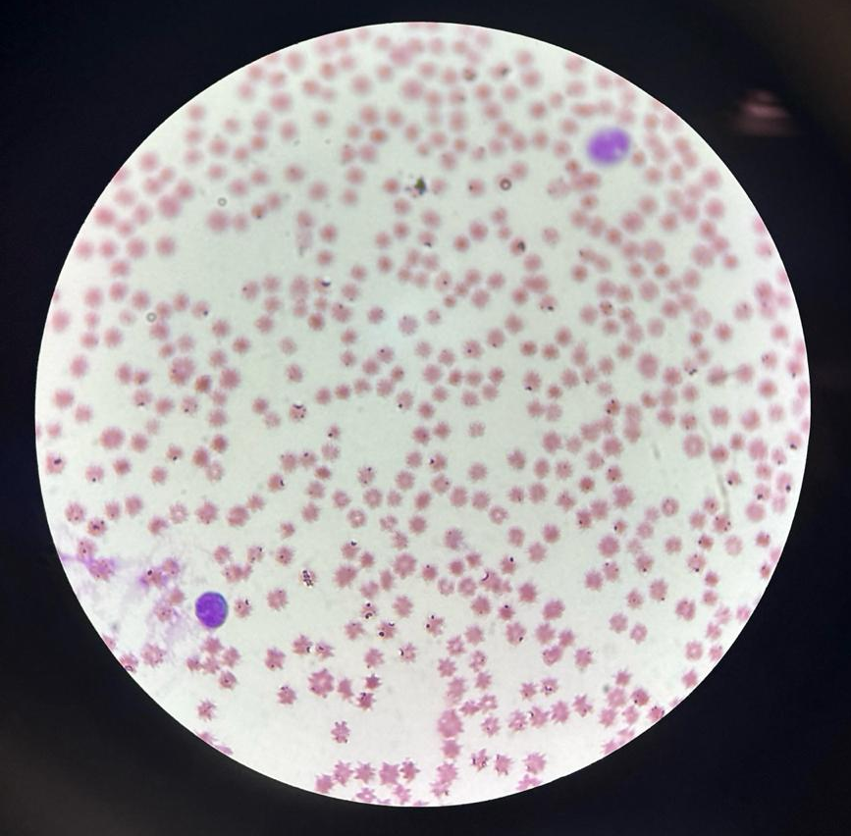
A CONGENITAL ANAPLASMOSIS IN BOVINE NEONATE: CASE REPORT
Larissa Miranda Padilha¹; Bianca Paola Santarosa¹; Karen Nascimento da Silva¹; Viviani Gomes¹.
¹Department of Clinical Medicine, Faculty of Veterinary Medicine and Animal Science, University of São Paulo
INTRODUCTION
Congenital transmission of Anaplasma marginale is described in bovine neonates as a differential diagnosis for causes of anemia and icterus, with the transplacental transmission mechanisms being poorly understood. This phenomenon primarily occurs during the middle and late stages of gestation, highlighting a fetal infection rate of 2.1% in animals born in endemic regions and 36.0% in those descended from infected females during gestation. The growing evidence of this transmission route underscores its importance in determining hemoparasitosis in newborns during the first week of life.
OBJECTIVE
The objective of this report is to describe the clinical and pathological findings of a case of congenital Anaplasmosis in a male Holstein neonatal calf, presenting clinical manifestations evident at 14 days of age, originating from a dairy farm in the countryside of São Paulo.
MATERIAL AND METHODS
On the fourth day of life, the animal was transported to the Calf Research Laboratory at FMVZ/USP. Upon clinical examination, apathy, hyporexia/anorexia, hyperthermia (>39.5ºC), diarrhea (score 3), hematochezia, and 8% dehydration were detected, with progression to icteric oral and conjunctival mucous membranes.
Dehydration was corrected with oral and intravenous fluid therapy using Ringer Lactate solution. Blood samples were collected via jugular vein puncture for hemogram, biochemical analysis, hemogasometry, and blood smear examination. Additionally, fecal samples were collected for microbiological culture.
RESULTS AND DISCUSSION
The hemogram revealed moderate anemia with slight leukopenia due to lymphopenia, as well as hypoproteinemia and hyperfibrinogenemia. Biochemical analysis showed increased total bilirubin, primarily indirect bilirubin, along with hypoglobulinemia. Hemogasometry revealed metabolic acidosis characterized by decreased pH (7.25), HCO3- 13.6mmol/L, base deficit 10.8mmol/L, and an elevated anion gap of 11.6mmol/L. Unfortunately, the animal progressed to death.
¹BRUN-HANSEN et al. (2006);
²KANEKO et al. (2008).
At necropsy, icterus was observed on the surface of all organs, with congestion of the lung lobes accompanied by areas of petechiae and suffusions. The margins of the hepatic lobes were rounded, and the gallbladder contained a significant amount of dark bile. Microbiological culture of the feces revealed the presence of Salmonella enterica spp. Blood smear examination showed the presence of basophilic rounded bodies on the edges of erythrocytes in all fields evaluated, reflecting approximately 50% parasitemia by Anaplasma marginale.
Table 1. Hemogram and biochemical variables with reference values
Parameter | Values | Reference Interval
Red blood cell | 4.03/µL | 8.55±2.75¹
Hemoglobin | 4.5g/dL | 10±31¹
Hematocrit | 13.4% | 30.45±8.45¹
MCV | 33.1fL | 36.95±2.95¹
MCHC | 33.7g/L | 34.9±1.1¹
Leukocytes | 6.24×10³/µL | 12±3.9¹
Neutrophil | 3.32 × 10³/µL | 4.95±2.75¹
Lymphocytes | 2.23 ×10³/µL | 5.65±2.15¹
Monocytes | 0.43 ×10³/µL | 0.8±0.5¹
Eosinophil | 0.13 ×10³/µL | 0.2±0.1¹
Basophil | 0.07 ×10³/µL | 0.08±0.05¹
Total bilirrubin | 10.19mg/dL | 0.25±0.5²
Indirect bilirrubina | 9.51mg/dL | 0.03±0.5²
Direct bilirrubina | 0.68mg/dL | 0.24±0.2²
Globulin | 2.27g/dL | 3.3±0.7²
Total protein | 4.01g/dL | 6.04±0.76²
Fibrinogen | 900mg/dL | 300±100²
Figure 1. Microscopic images of blood smear slides with presence of Anaplasma marginale.
CONCLUSION
This case report was diagnosed as congenital anaplasmosis, as the calf was raised in an experimental housing system without contact with ectoparasites. The clinical progression may have been exacerbated by the stress of transportation and the development of neonatal diarrhea. The diagnostic confusion hindered the timely implementation of appropriate treatment.
ACKNOWLEDGMENTS
^{FONTE: GeCria, 2024}

